Slide 1


Creating a Tableau
Dashboard on the FRIENDS TV Show
Dataset
This presentation outlines the process of creating a Tableau dashboard using the FRIENDS TV Show dataset. We will cover data collection, preparation, analysis, and visualization.
Presented by:-
6867 SRUSHTI FULPAGAR
MSCDA
SR.NO:- 36

Slide 2






Introduction to the FRIENDS TV Show
1
A Popular Sitcofi
FRIENDS is a popular American sitcom that aired from 1994 to 2004, following the lives of six friends living in New York City.
2
Characters & Relationships
The show features memorable characters like Rachel, Monica, Phoebe, Joey, Chandler, and Ross, who navigate their relationships, careers, and personal lives.
3
Thefies and Hufior
The show explores themes of friendship, love, and family with witty humor, relatable situations, and endearing characters.
4
Cultural Ifipact
FRIENDS remains a popular show that has had a significant impact on pop culture, inspiring fashion, music, and memorable catchphrases.

Slide 3


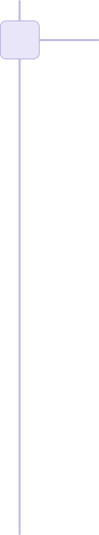


Data Collection and Preparation
1
Source of Data
The data for this project is sourced from various online databases, fan wikis, and publicly available resources containing episodes, transcripts, and character information.
2
Data Cleaning and Transforfiation
The collected data needs to be cleaned, standardized, and transformed into a format suitable for Tableau analysis. This may involve removing duplicates, handling missing values, and converting data types.
3
Data Integration
Different data sources need to be combined and integrated into a single dataset to provide a comprehensive view of the FRIENDS TV Show.

Slide 4
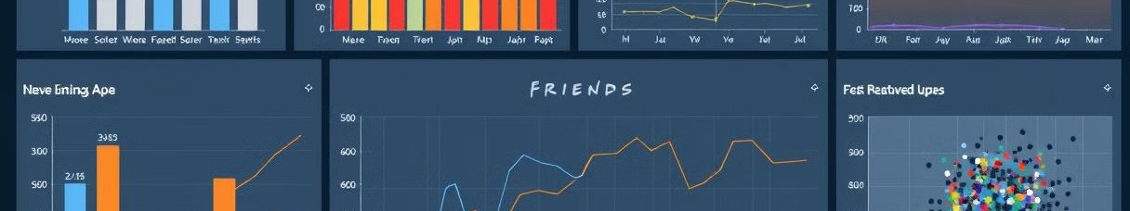
Exploratory Data Analysis
Frequency of Character Appearances | Dialogue Analysis and Sentiment | Relationship Dynamics
Popularity of Locations | Recurring Themes and Jokes | Episode Length and Viewership Trends

Slide 5
Designing the Dashboard Layout
Target Audience
Consider the target audience for the dashboard and what insights they are most interested in.
Data Hierarchy
Organize the dashboard around a clear data hierarchy, starting with high-level overviews and drilling down to more detailed information.
Visual Aesthetics
Choose a visually appealing and informative design that enhances the usability and accessibility of the dashboard.

Slide 6
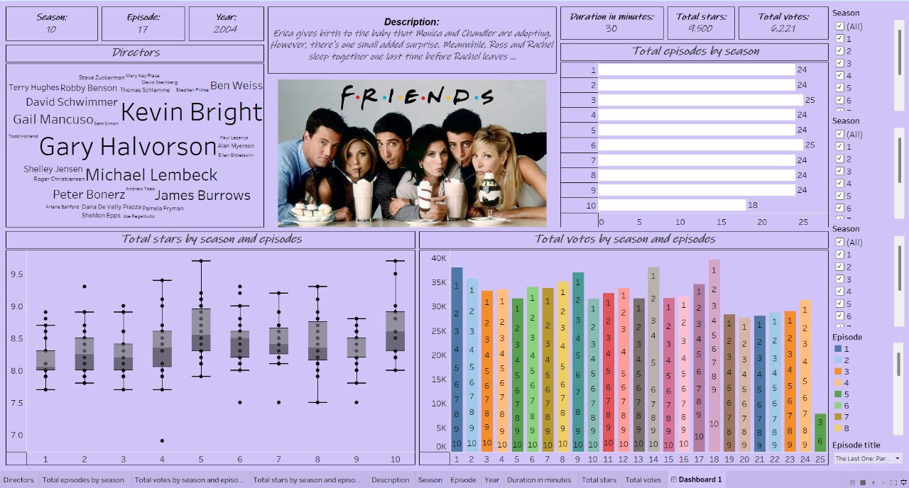
Dashboard

Slide 7
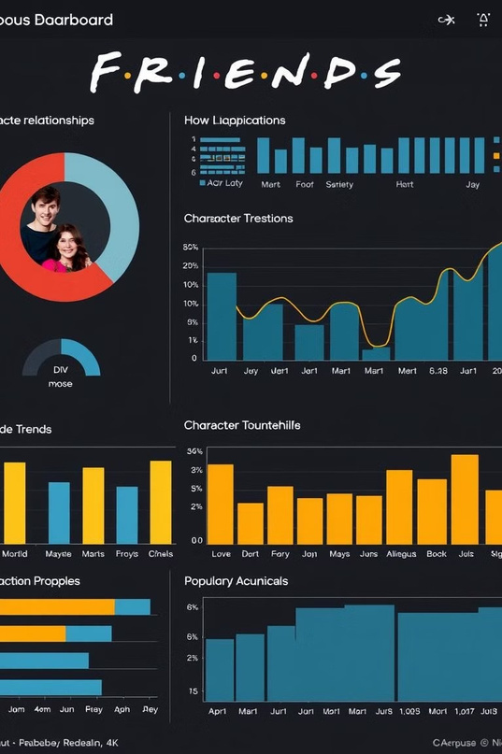

Visualizing Key Metrics and Insights
Character Appearances
1
Use a bar chart to show the frequency of each character's appearances across the entire show.
Dialogue Analysis
A word cloud can illustrate the most commonly used words or phrases by each character.
2
Episode Trends
A line graph can visualize the trend of episode length over time, or show how viewership ratings changed throughout the series.
3

Slide 8

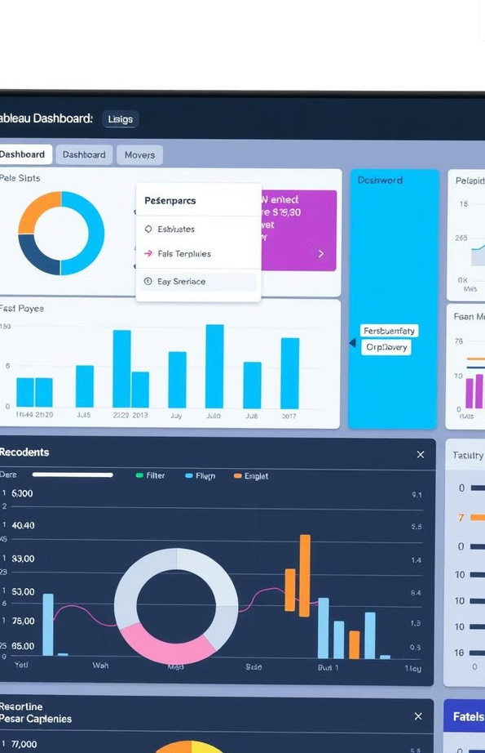




Interactive Dashboard Features
Filters
Filters allow users to select specific characters, seasons, or episodes to focus on.
Sliders
Sliders can be used to adjust ranges for data values, like episode duration or number of characters.
Dropdowns
Dropdowns provide options for selecting specific categories or attributes, such as location or theme.
Drill-Down
Enable users to drill down into specific details by clicking on data points, like exploring individual episodes or character relationships.

Slide 9



Conclusion and Next Steps
Insights and Applications
The dashboard provides valuable insights into the FRIENDS TV show, enabling fans, researchers, and producers to explore various aspects of the show.
Further Enhancefients
Future improvements might include adding more data sources, incorporating user feedback, and exploring advanced data visualization techniques.

Slide 10
THANKYOU!!!

